Slide 1
Parts of the seed

Slide 2
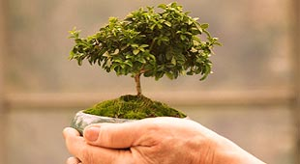
Purpose of Seeds
1. __________ and protect the growing plant

Slide 3
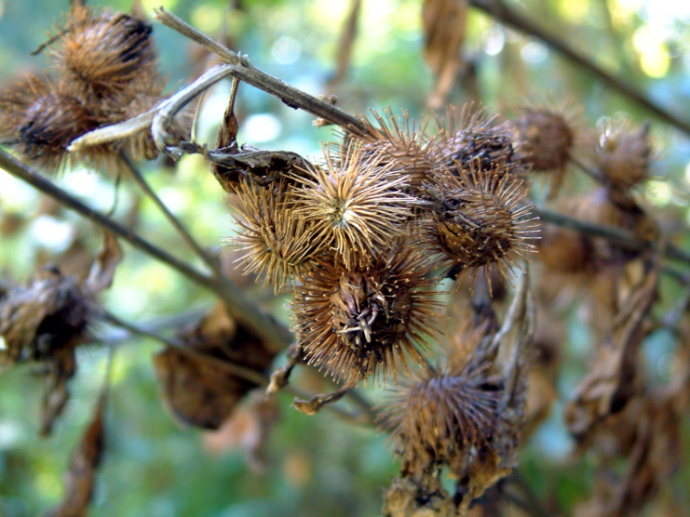
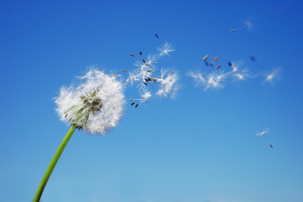
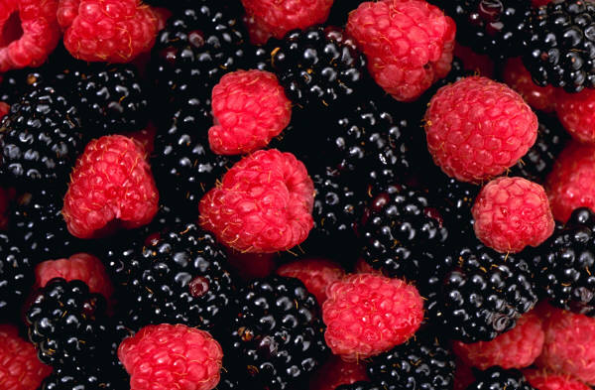
Purpose of Seeds
2. Force the seed to ________
Burrs
Attached to fruit
Wind

Slide 4
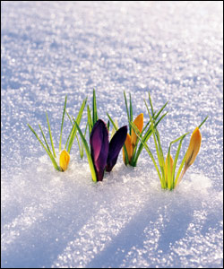
Purpose of Seeds
3. Stop the plant from growing in _____________ conditions

Slide 5
All Seeds Have:
____________________
Protects the plant inside the seed and prevents water evaporation
Cotyledon(s)
Store __________

Slide 6
All Seeds Have:
Plumules
Become the plant’s first true __________
Radicle
Becomes the __________

Slide 7
Monocot Seeds Also Have:
Endosperm
Extra __________ storage for the developing plant

