Slide 1
GRADING MAPLE SYRUP

Slide 2
How do we know it’s syrup?
There are 4 main methods to determine when sap is syrup

Slide 3
1. Sheeting or Aproning
Use a large metal spoon, or small metal ladle
Take a sample of the syrup that is boiling and tip it sideways
Watch the syrup come off the spoon – if it drips, it isn’t done; if it comes off in a sheet, it is done

Slide 4
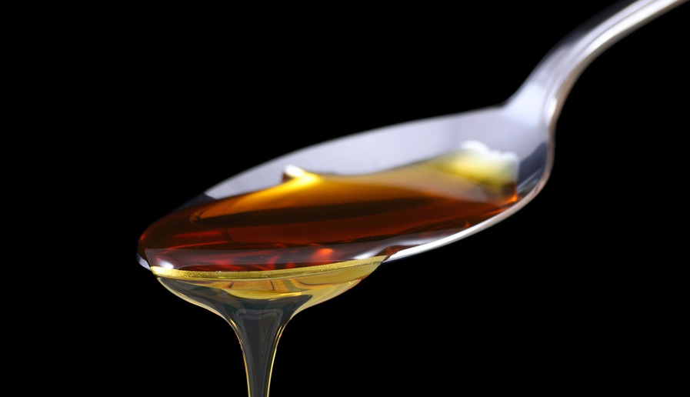
1. Sheeting or Aproning

Slide 5
2. Temperature
We know that syrup boils at 7.3ºF above the boiling point of water
Boil water every time you are running the evaporator, and record the temperature
Monitor the temperature of the boiling sap, and remove it when it reaches 7.3ºF above the boiling point of water

Slide 6
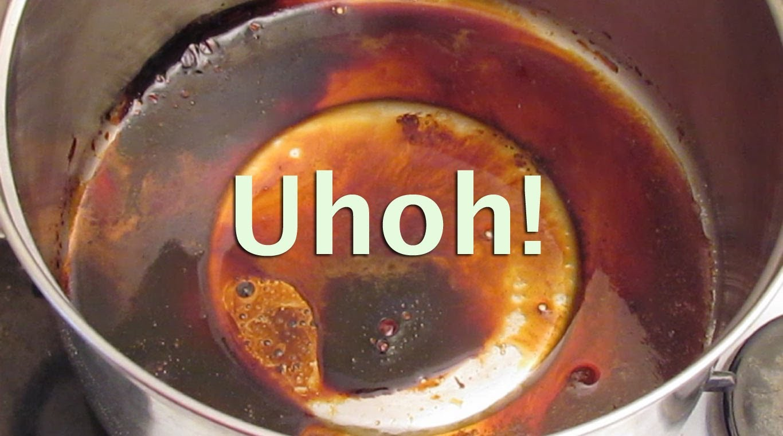
2. Temperature

Slide 7
3. Hydrometer
Hydrometers use density – syrup is more dense than sap
A hydrometer floats in the syrup sample, either when boiling or at room temperature
When it floats at the appropriate depth, the syrup is done

Slide 8
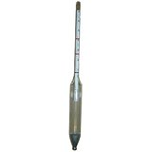
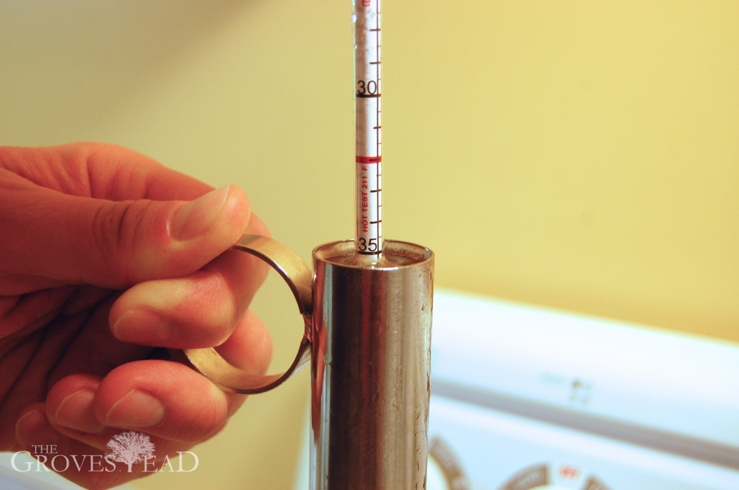
3. Hydrometer

Slide 9
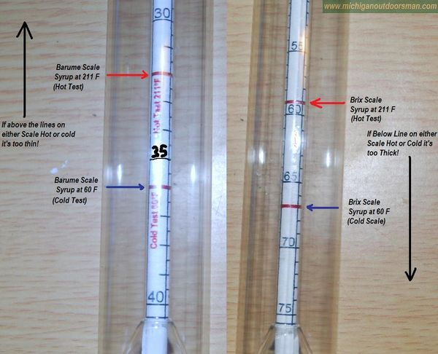
3. Hydrometer

Slide 10
4. Refractometer
These rely on the way light travels through liquids – it is different in syrup than in sap
A small sample is used, and the device measures the path of light as it travels through the liquid

Slide 11
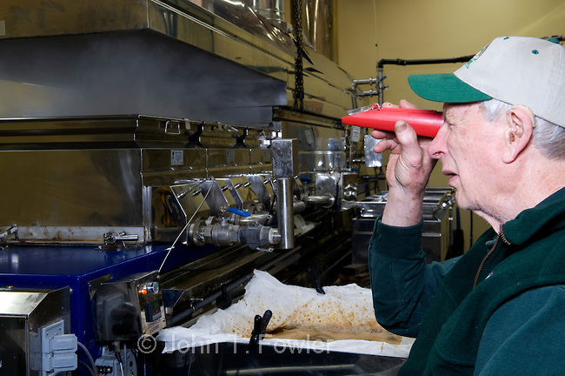
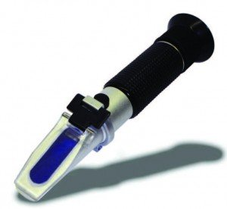
4. Refractometer

Slide 12
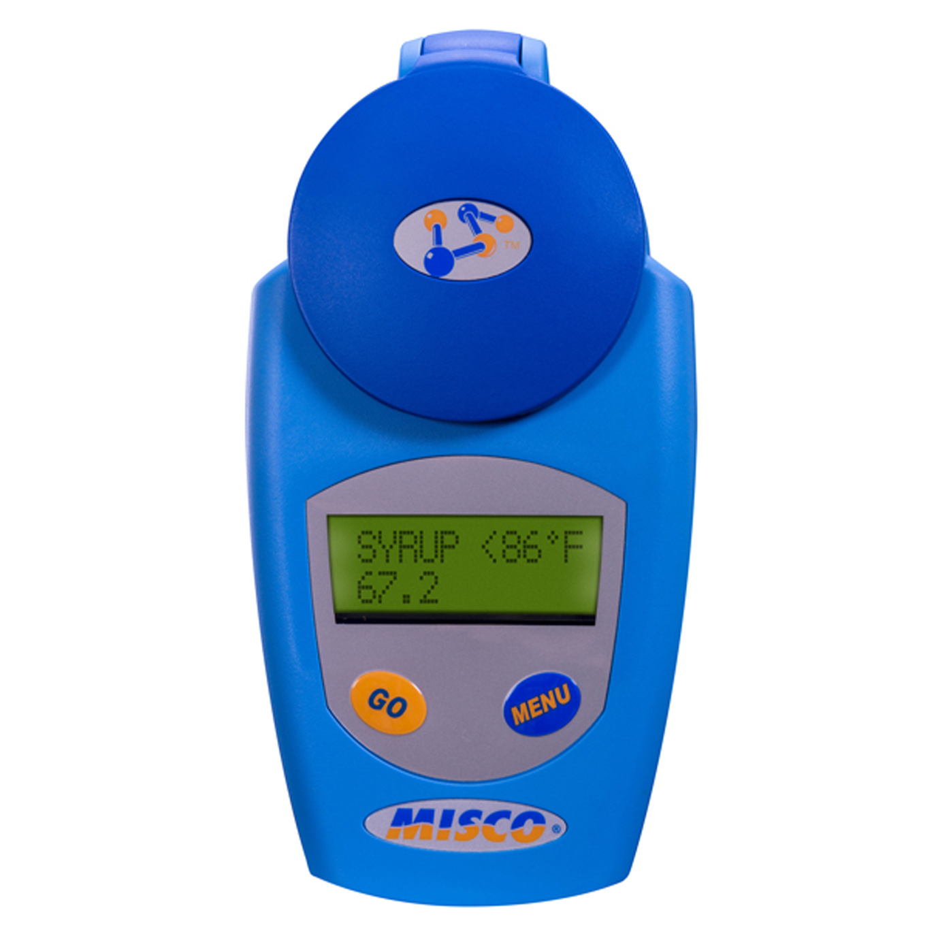
4. Refractometer

Slide 13
Grading Maple Syrup
All maple syrup that is sold in Canada must be graded
This tells the buyer three things:
The quality
The flavour
How it should be used
Remember, these are just guidelines

Slide 14
Grading Maple Syrup
Grading can depend on environmental factors (like disease), but is mainly determined by when the tree is tapped the length of time the syrup is boiled
All maple syrup that is sold must have a label, and this information must be included on the label

Slide 15
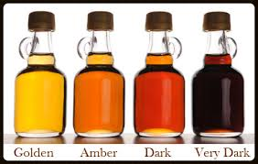
Ontario Grade A – Golden
For a delicate taste
Must not ferment
Must be clear
Must have a maple flavour and be free of any unpleasant odours or flavours

Slide 16
Ontario Grade A – Golden
Golden syrup is from the earliest sap runs
It is the first syrup to be bottled and sold
It is also known as fancy and is the most expensive

Slide 17
Ontario Grade A – Amber
For a rich taste
Must not ferment
Must be clear
Must have a maple flavour and be free of any unpleasant odours of flavours

Slide 18
Ontario Grade A – Dark
For a robust taste
Must not ferment
Must be clear
Must be free of any unpleasant odours or flavours but must contain traces of caramel, plant bud or sap flavours

Slide 19
Ontario Grade A – Very Dark
For a strong taste
Must not ferment
Must be clear
Must be free of any unpleasant odours or flavours but must contain traces of caramel, plant bud or sap flavours

Slide 20
Recommended Uses
Golden – pancakes, waffles
Amber – dessert topping, French toast
Dark– glazing, sweetening
Very Dark – Baking, flavouring

