Slide 1
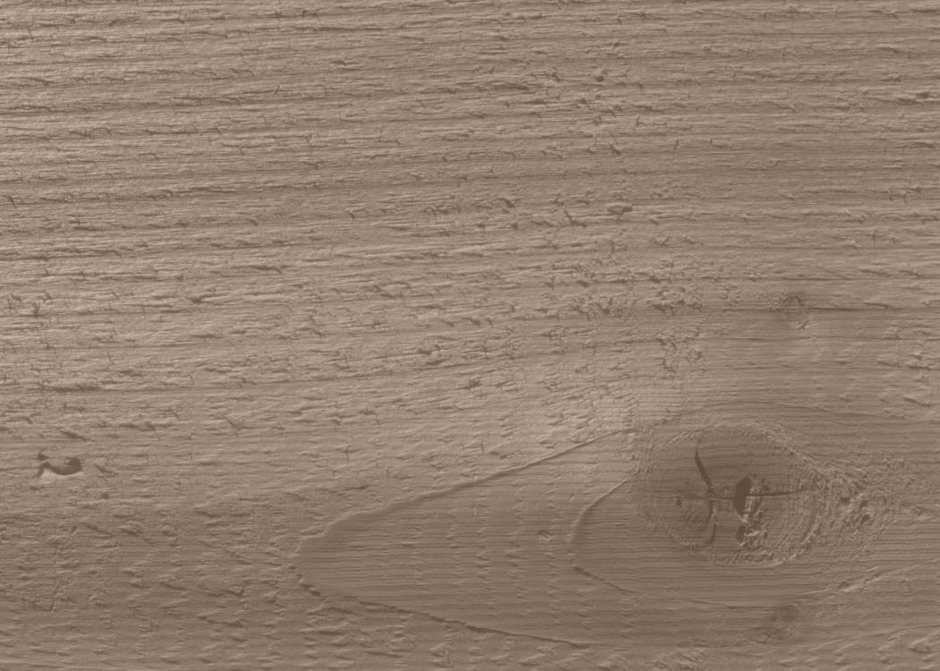
TIJ1OR
Exploring Technology
Ms. Carew & Mr.McMorrow

Slide 2
A little bit about the course
-This is a course about working with your own two hands
-This is a course about craftsmanship and the satisfaction of a job well done
-This is a course about turning ideas into real things
-This is a course about learning skills that will serve you for the rest of your life
-This is a course that could impact the rest of your life

Slide 3
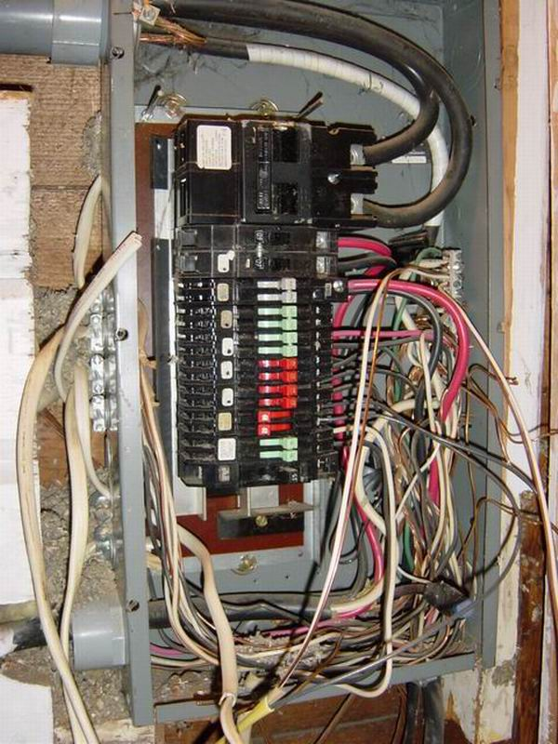
Electrical Panel
Tell me about this panel?
Tell me about the person who did this?
What is your first impression? What was your first thought?
Sloppy, Careless, Dangerous, Rushed, Unskilled, Lack of Respect, Ignorant

Slide 4
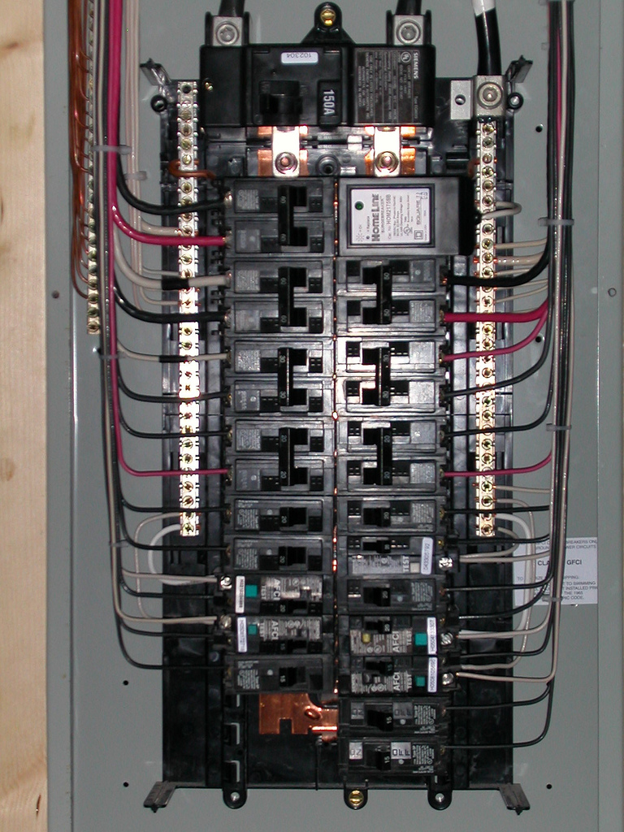
What do you have to say about this box?

Slide 5
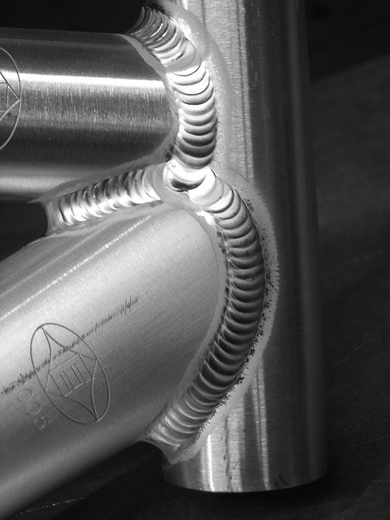
A TIG weld is one of the most difficult skills to master in the mechanical world.
I see….
Patience
Knowledge
Experience
Mastery
Dexterity
Artistic
Respect
Beauty

Slide 6
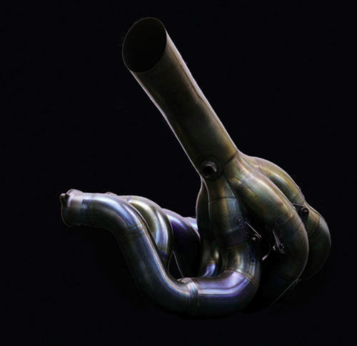
An Exhaust manifold from a Renault F1 race car. The only component of an F1 car that is still completely hand made.
What do you see?
In this piece of work I see…
Detail
Design
Dedication
Form
Craft
Satisfaction
Gratification
Art
Emotion
Beauty

Slide 7
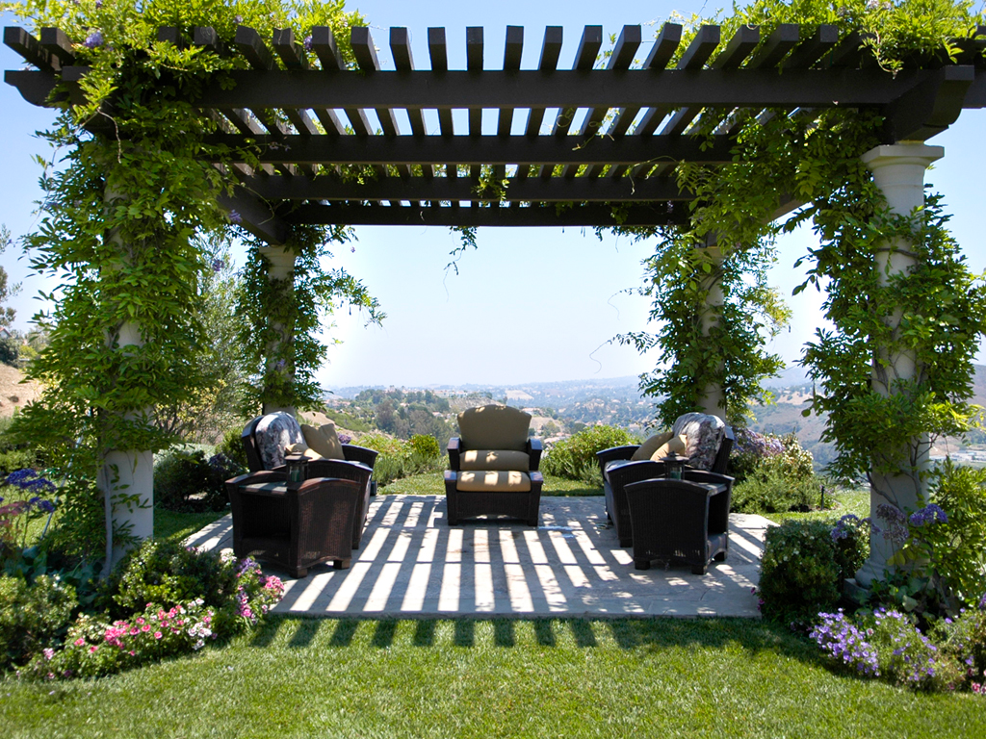
What can we say about this landscape structure?
What can we say about the people who constructed it?

Slide 8
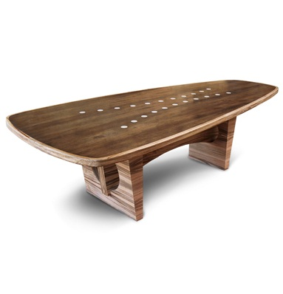
What can we say about this table?
What can we say about the maker of this table?

Slide 9
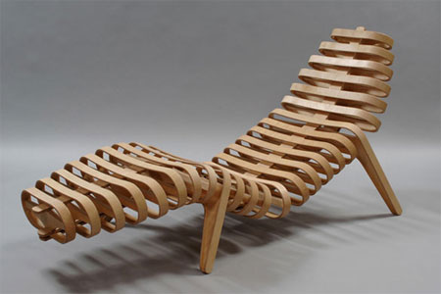
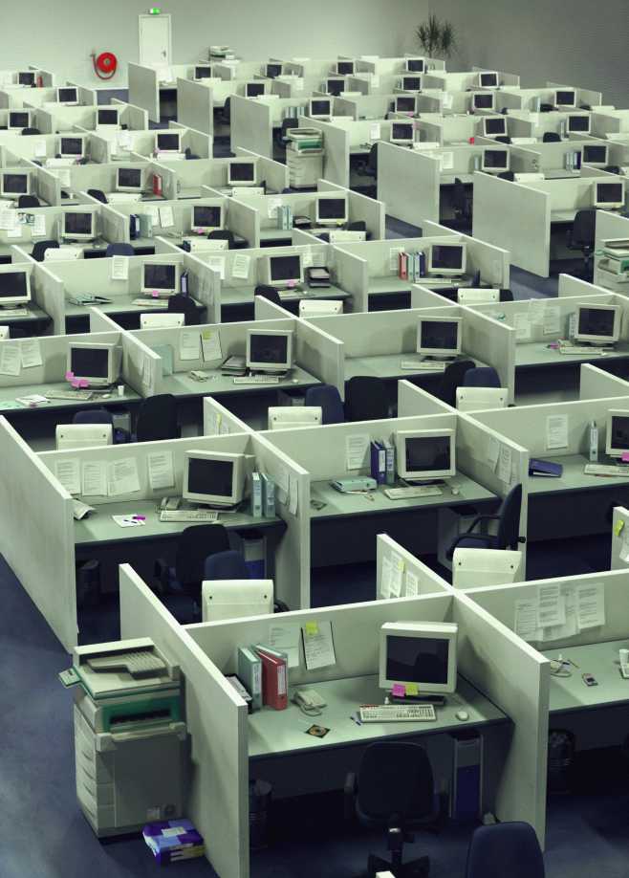
Craftsmanship
Knowledge Farm
vs
This class is about this
Not this

Slide 10
Safety
Safety is the most important concept to learn/practice this semester.
Safety is a “skill” you can/must become proficient at. Think of it as another thing to be good at.

Slide 11
Ultimately, you are responsible for your own safety in this class.
-It’s a sliver in your hand
-A cut on your arm
-Your missing finger
-Your life long disability
-Your Life
Working to prevent these events is all of our responsibilities together.

Slide 12
Our Job is to ensure the room and equipment is in a state that allows you to work safely as you have been instructed.
It is also our job to ensure you have all had the proper training for what ever task you are working on. “Training” does not mean you saw me or someone else do it once.
Unfortunately this means we must sign off individually on each machine/power tool we need to use.

Slide 13
General Classroom Rules
-Have some fun while we work together.
-Help each other if you can and if it is safe to do so.
-Respect the room/equipment/tools
-Respect each other.
This means being on time. (I know things happen though)
-Keep me informed
Trips
Sports
Relevant medical conditions
Outside influences that may impact your success in this course
-Book yourself in/out for the washroom/water breaks. One at a time.
Be respectful of your peers. Don’t take forever.
Let me know if you need an “extended” break. I will understand.
Sometimes that third burrito was not as good an idea as you thought.
-Don’t be rude. You would be amazed how far Please and Thank You will get you.
-Water only. No Food. Must stay on front benches
-Please don’t line up at the door before the bell rings.
I admit that this is a pet peeve of mine. Its more of a respect thing.
We should all be cleaning up anyway.

Slide 14
-Don’t Leave a mess!
The mess will be cleaned up before you leave. I’ll write a note to your next teacher to explain why you are late. The note will not be an excuse or justification for your lateness. It will ask that your next teacher treat you as late and to use their own discretion on how to deal with it.
-Cell phones have a time and place to be used. I trust you know when those are.
I can and will ask you to surrender your cell phone if it becomes a
problem. A cell phone jail/lockup will appear in our class in the next
week or two.
-Don’t assume, Just ask.
-Enjoy your time here. I assume you want to be here. So I will ask now. Please tell me if you don’t really want to be in tech or if you picked this course because you thought it would be an easy way to get a credit.
-Don’t build anything without a plan, sketch, or drawing. Never Ever Ever.
-Make awesome stuff and have fun doing it.

